Slide 1


Presentation of our game
The Legendary World: Eldorado

Slide 2


Why should you install our game ?
Because it is easy to understand
Even your grandma or your daughter could play

Slide 3

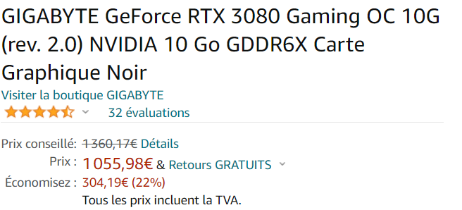
Why should you install our game ?
You can play with every pc

Slide 4
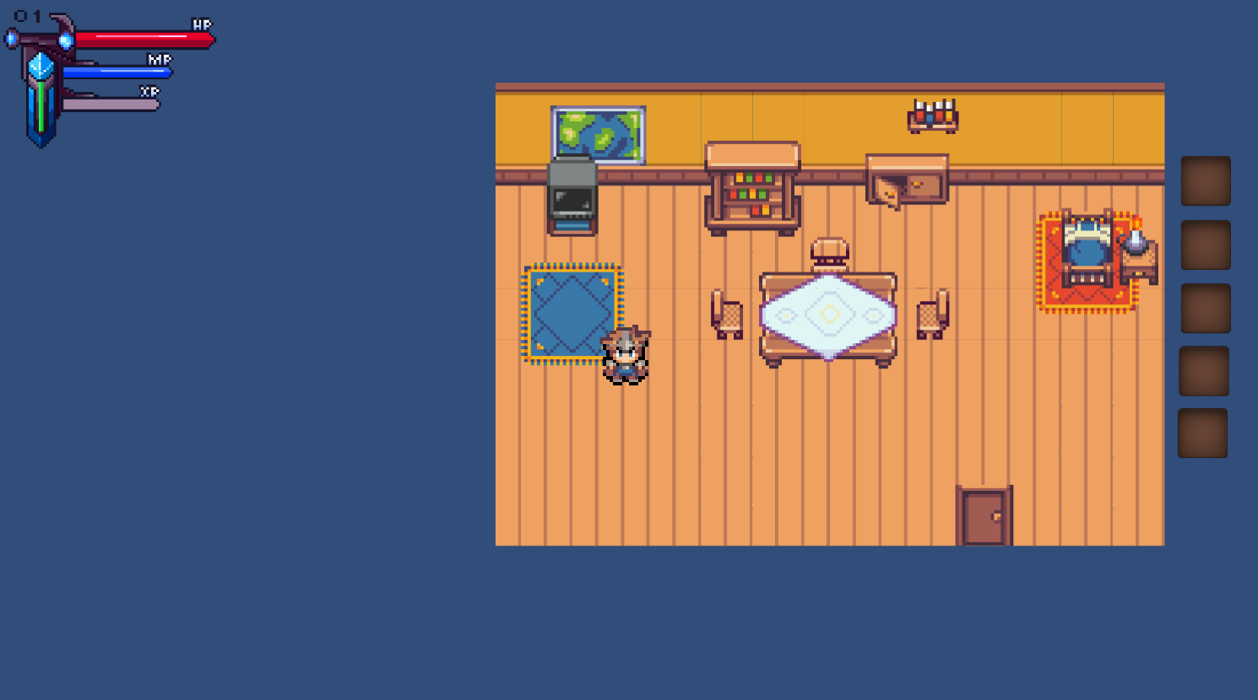
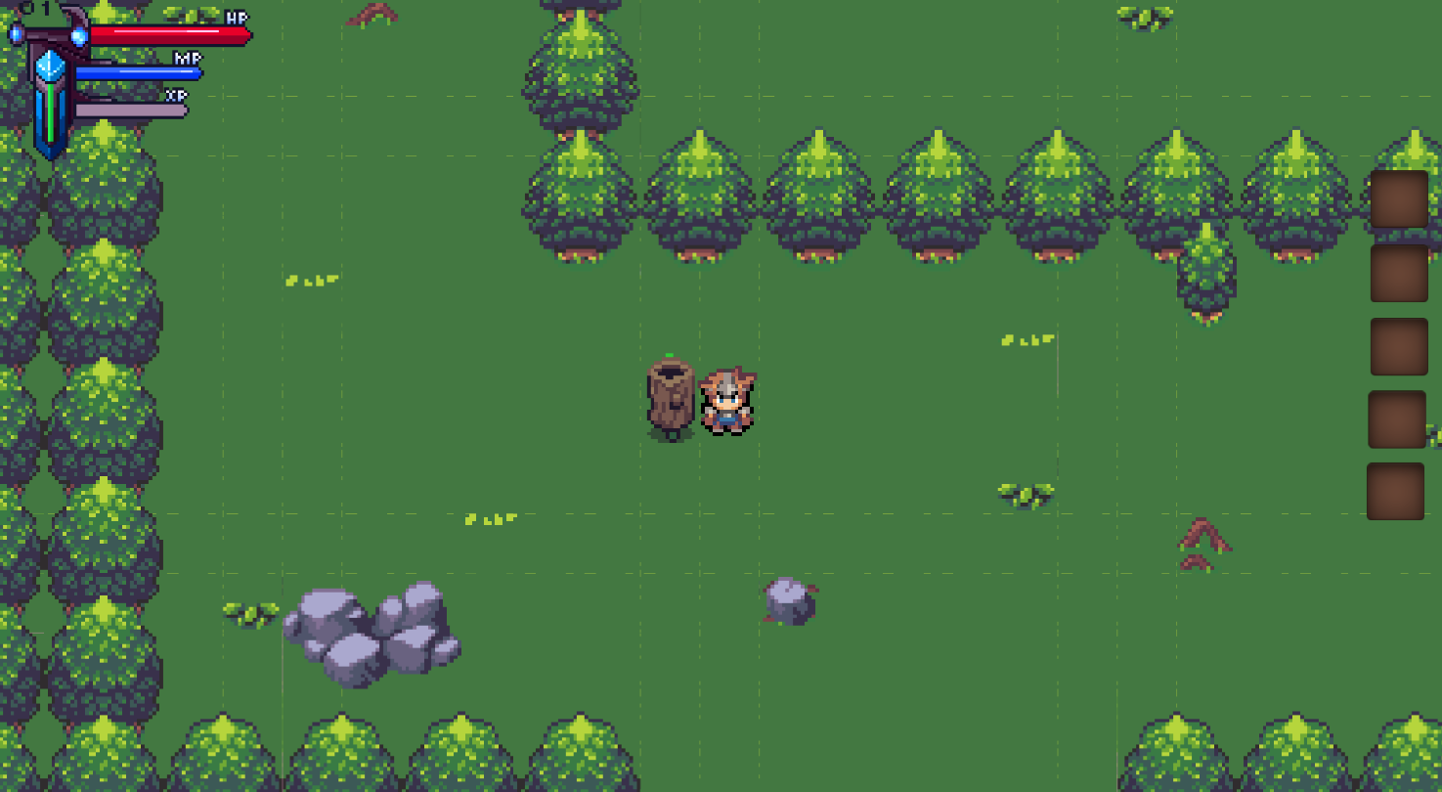
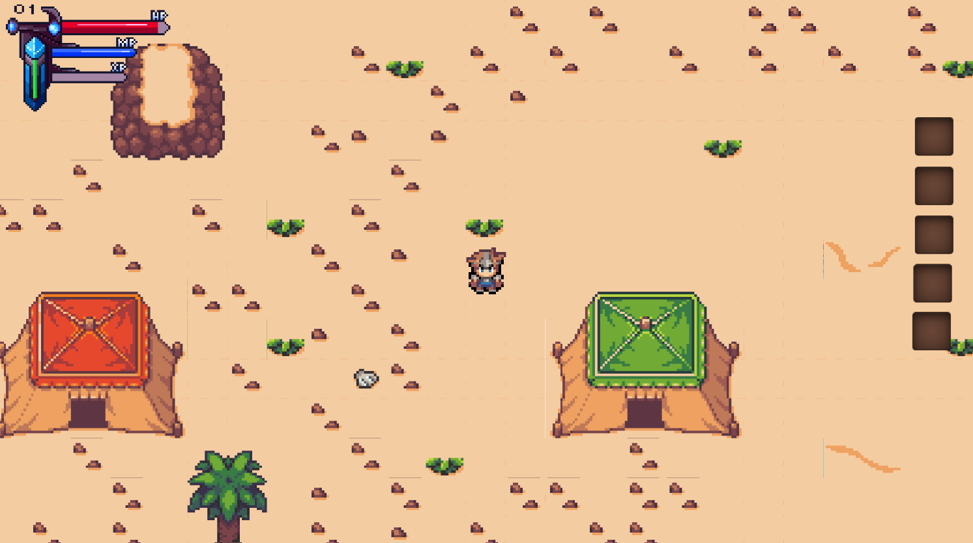
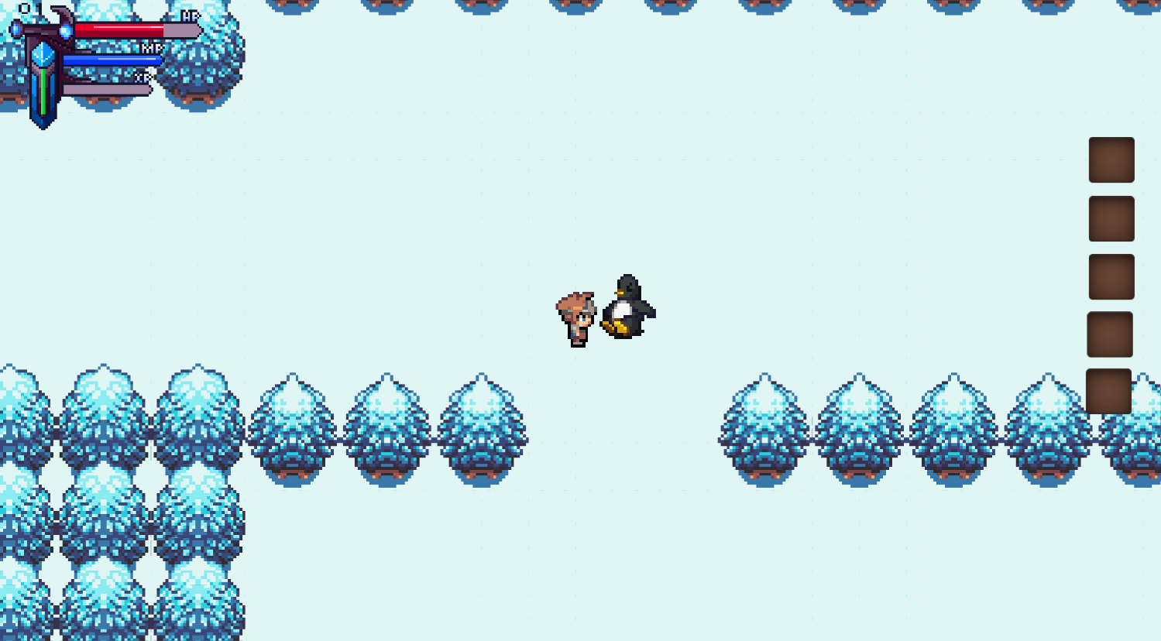



Why should you install our game ?

Slide 5
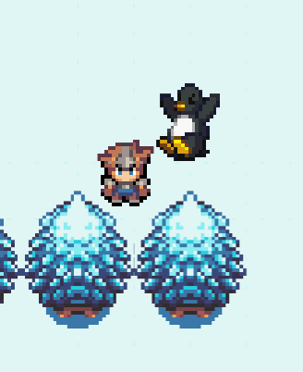
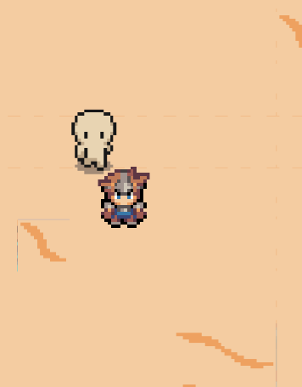
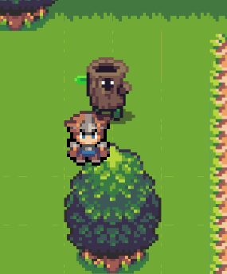

Why should you install our game ?
We got good looking enemies

Slide 6
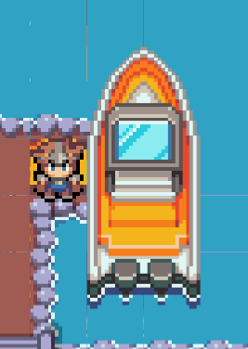
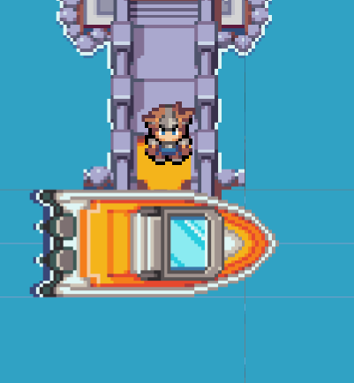

Why should you install our game ?
Teleportation

Slide 7

Why should you install our game ?
There is some song to entertain you !

Slide 8




Why should you install our game ?
There are some merchant

Slide 9

The End

Slide 10
Sources
https://www.google.com/imgres?imgurl=https%3A%2F%2Fwww.lahalle.com%2Fdw%2Fimage%2Fv2%2FBCHM_PRD%2Fon%2Fdemandware.static%2F-%2FSites-lahalle_master%2Fdefault%2Fdw53c75ec7%2Fblouse-manches-courtes-jaune-moutarde-fille-b-36165600701411052.jpg%3Fsw%3D300%26sh%3D400&imgrefurl=https%3A%2F%2Fwww.lahalle.com%2Ffille-1&tbnid=NF5gn2EzuZCNYM&vet=12ahUKEwi-5vnsi6L4
https://www.comment-economiser.fr/61-remedes-de-grand-mere-testes-et-approuves.htmlAhWtX_EDHbTZCWUQMygDegUIARDfAQ..i&docid=dtYjY_ambzvNKM&w=300&h=400&q=fille%20enfant&client=opera-gx&ved=2ahUKEwi-5vnsi6L4AhWtX_EDHbTZCWUQMygDegUIARDfAQ
https://www.commentjijoiiojoi-economiser.joijoijoijfr/jvhjvjhvjh61-remedes-de-grand-mere-testes-et-approuves.htmlAhWtX_EDhuhuh vhdfhb jbHbTZCWUQMygDegUIARDfAQ..i&docid=dtYjY_ambzvNKM&w=300&h=400&q=fille%20enfant&client=opera-gx&ved=2ahUKEwi-5vnsi6L4AhWtX_EDHbTZCWUQMygDegUIARDfAQ
https://www.commentjijoiiojoi-economiser.joijoijoijfr/jvhjvjhvjh61-remedes-de-grand-mere-testes-et-approuves.htmlAhWtX_EDhuhuh vhdfhb jbHbTZCWUQMygDegUIARDfAQ..i&docid=dtYjY_ambzvNKM&w=300&h=400&q=fille%20enfant&client=opera-gx&ved=2ahUKEwi-5vnsi6L4AhWtX_EDHbTZCWUQMygDegUIARDfAQ
https://wwwfyfytfyf.comfmentjijoiiojoi-economiser.joijoijoijfftyfytfytfr/jvhjvjhvjh61-remedes-de-grand-mere-testes-et-approuves.htmlAhWtX_EDhuhuh vhdfhb jbHbTZCWUQftffgMygDegUIARDfAQ..i&docid=dtYjYtftftyfyt_ambzvNKM&w=300&h=400&q=fille%20enfant&client=opera-gx&ved=2ahUKEwi-5vnsi6L4AhWtX_EDHbTZCWUQMygDegUIARDfAQ
https://www.jgjhgh.gjoijoijoijfr/g&ved=2ahUKEwi-5vnsi6L4AhWtX_EDHbTZCWUQMygDegUIARDfAQ

